Slide 1
Securing Software Systems via Fuzz Testing and Verification
CHEN Hongxu (G1502414K)
Supervisor: Prof LIU Yang
28/Nov/2019
Notes:
Good morning everyone, welcome to my oral defense. My research topic is xxx, my name is CHEN Hongxu and my supervisor is Professor LIU Yang.

Slide 2

Why Testing & Verification for Security?
Testing
Easy to conduct
Relatively straightforward
Can detect implementation vulnerabilities
Verification
Hard to conduct
Usually require abstraction
Can prove absence of vulnerabilities in various aspects

Slide 3
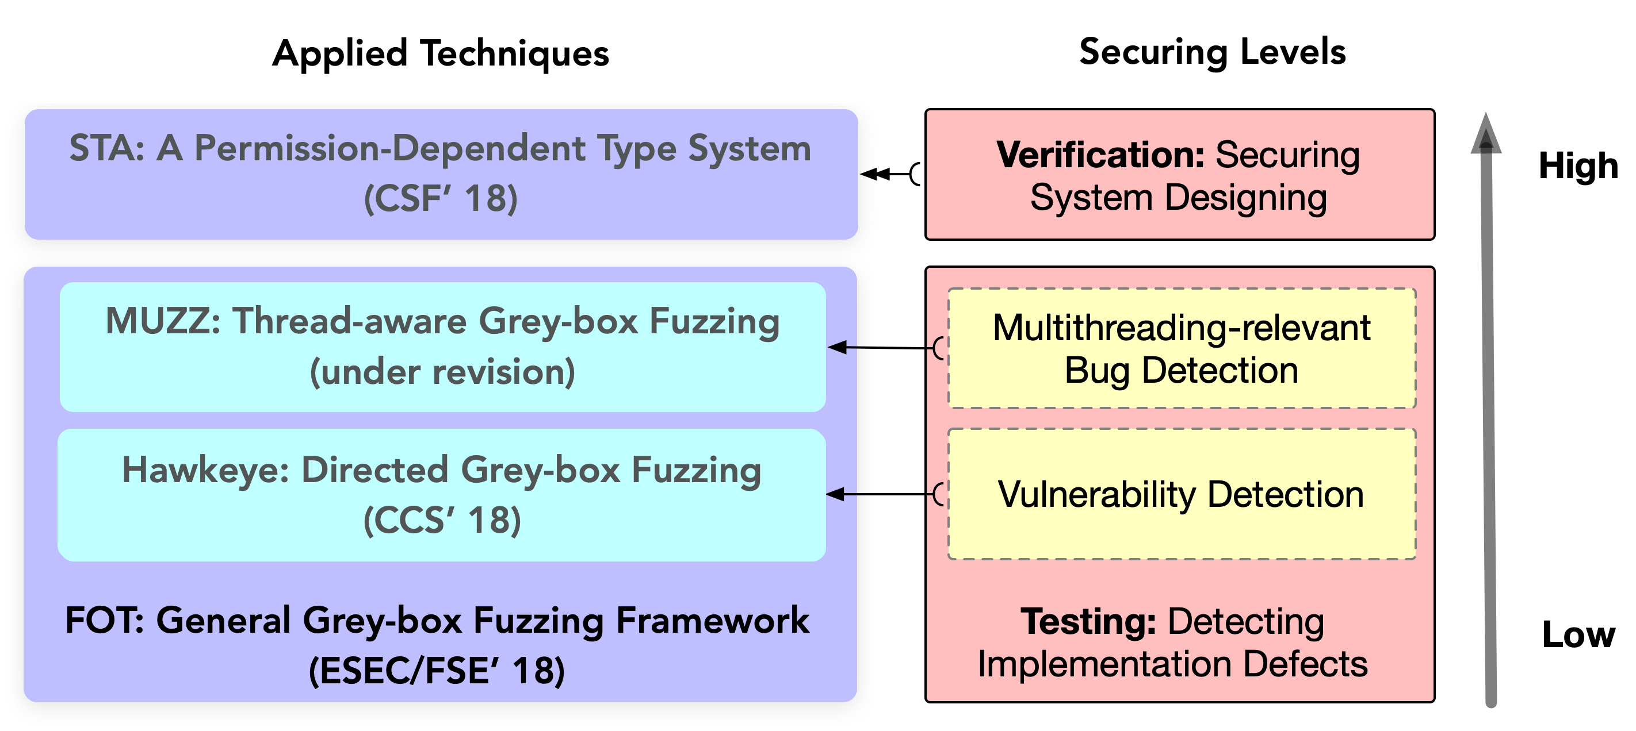
Thesis Contributions
Notes:
My thesis contributions are as follows:
Hawkeye for directed fuzzing, CCS’18
MUZZ for thread-aware fuzzing, under revision
FOT for framework, ESEC/FSE’18

Slide 4
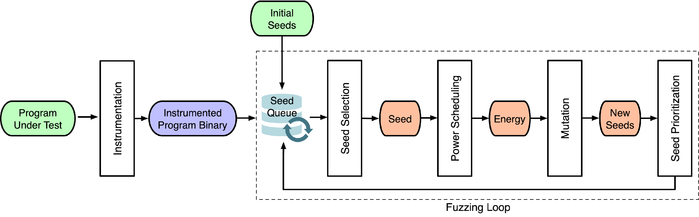
Grey-box Fuzzing (1) - Workflow
Automatic Testing
Program Feedback
Mutation on Seeds
15,000+ vuls found by fuzzers
70+ papers in past 3 years

Slide 5
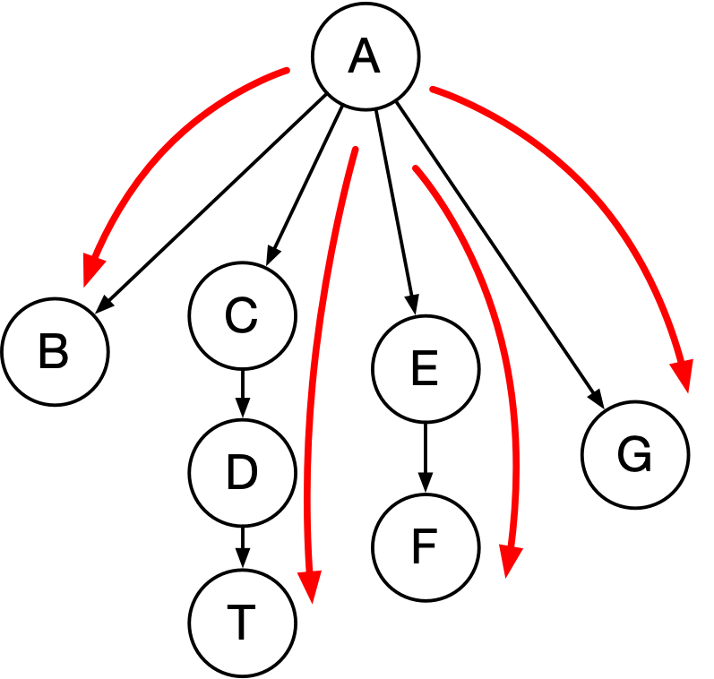
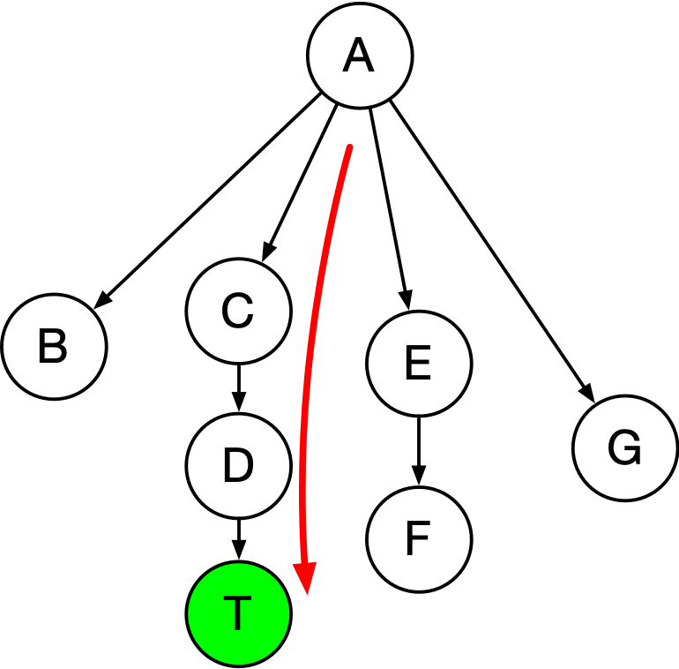
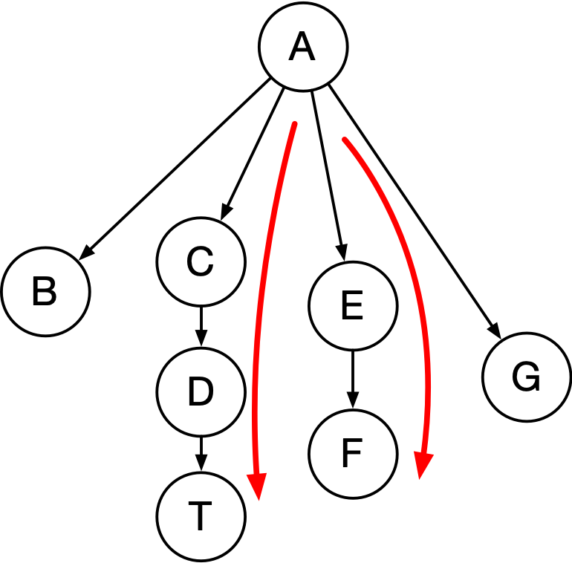
Grey-box Fuzzing (2) - Categorization
General-purpose Fuzzing
Directed Fuzzing
Specific-flow Fuzzing

Slide 6
Hawkeye: Directed Grey-box Fuzzing

Slide 7
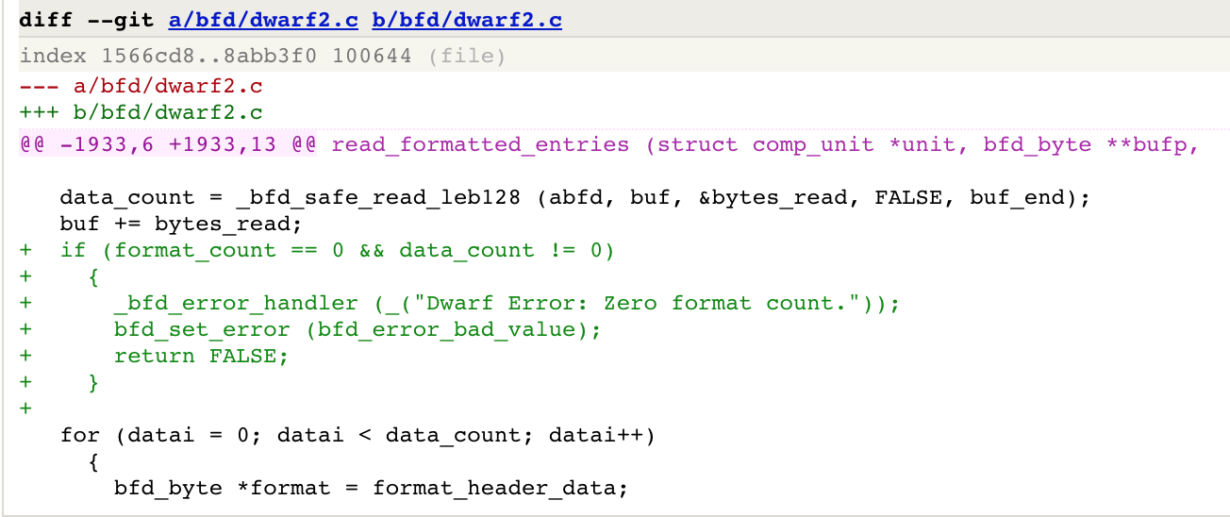
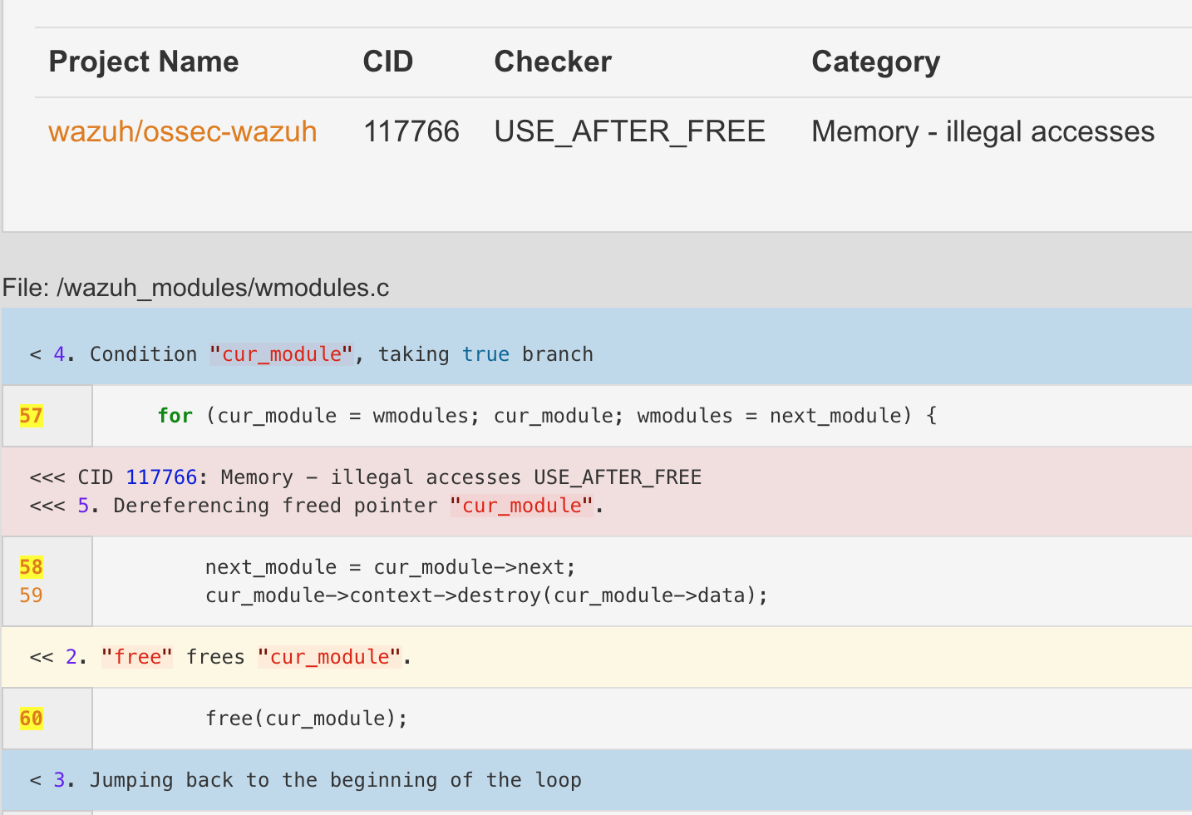
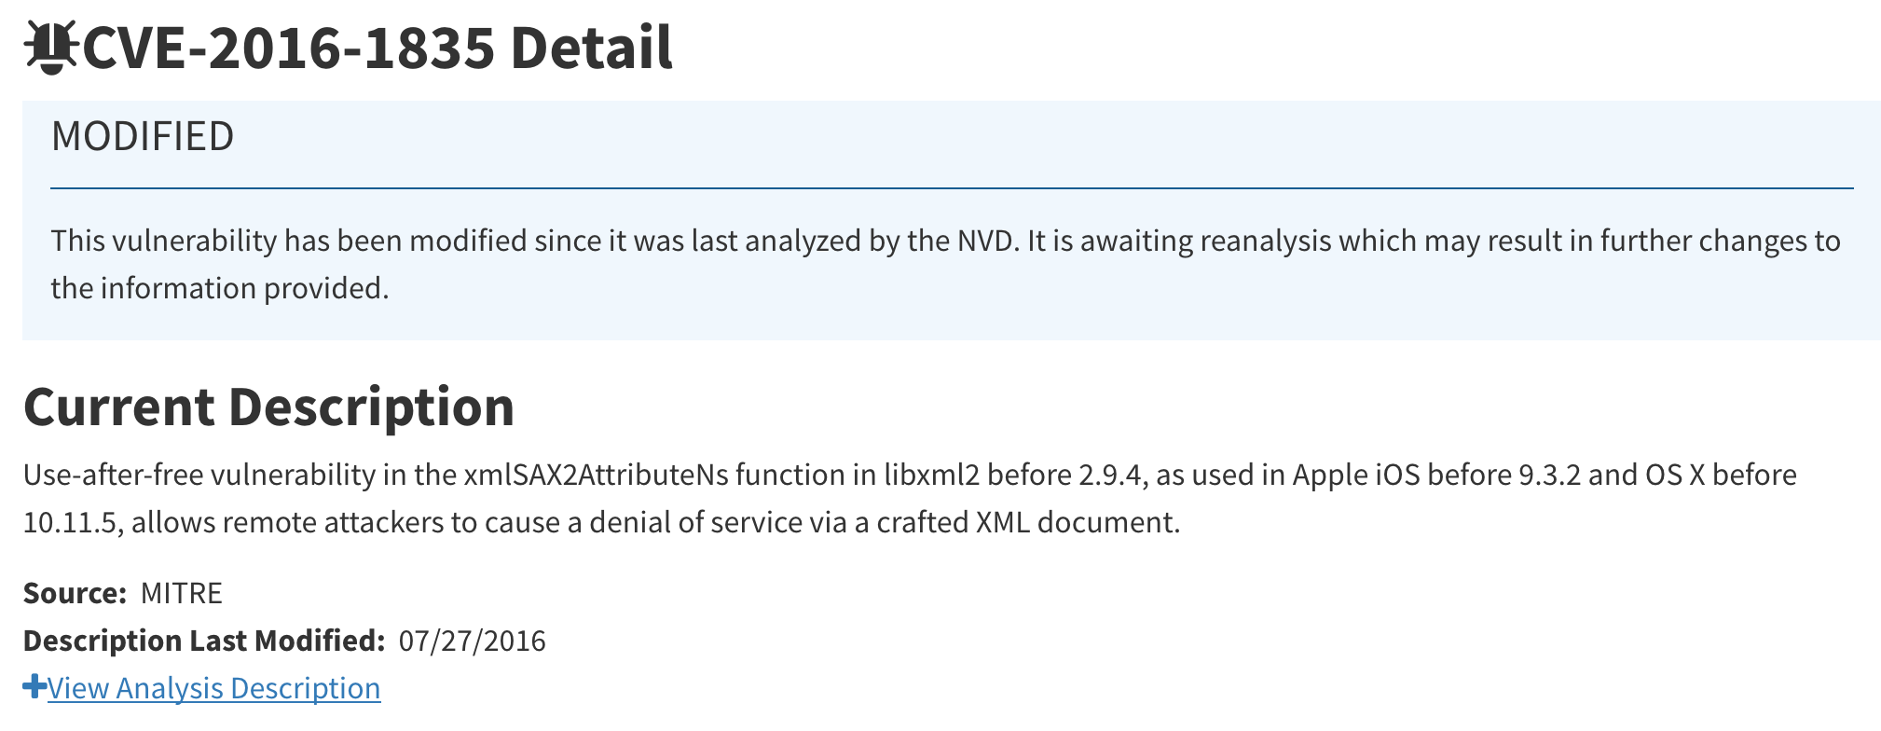
Why Directed Grey-box Fuzzing (DGF)
Test patches
Reproduce crashes
Justify vulnerabilities
...

Slide 8
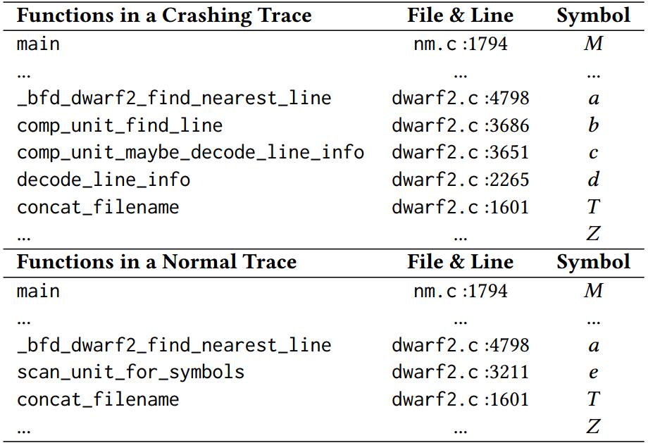
Motivating Example
Given a patch for GNU Binutils nm CVE-2017-15023
Target T is dwarf2.c:1601 in concat_filename
traces reachable to T
M → … a → b → c → d → T
M→ ... a → e → T

Slide 9
Desired Properties for DGF
P1: Provide a distance metric avoiding bias to traces reachable to targets
All traces reachable to the target should be considered
P2: Balance cost-effectiveness between static analysis and dynamic analysis
static analysis precision’s impacts on dynamic fuzzing
P3: Prioritize proper seeds and schedule mutations
deprioritize seeds with less chances to reach target locations
schedule more powers on “good” seeds
P4: Apply adaptive mutations to increase mutators’ effectiveness
fine-grained mutations for traces close to target locations

Slide 10
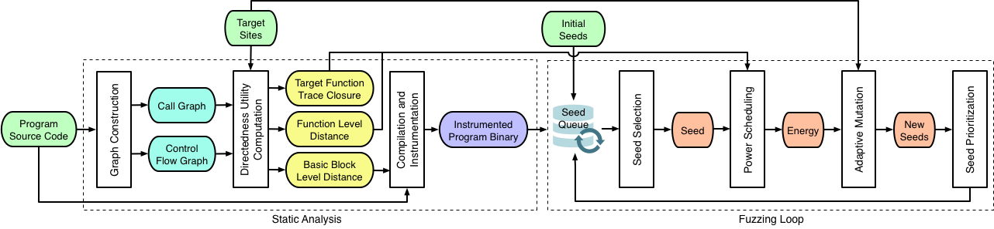
Workflow of Hawkeye

Slide 11
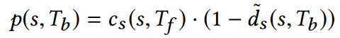
Power Function
C_{s} favors longer traces that share more executed functions with the “expected” traces
d_{s} favors shorter traces that reach the expected targets
Used directly for power scheduling

Slide 12
Adaptive Mutation
When a seed has reached target functions, prefer fine-grained mutations
Fine-grained: bit/byte level flips, add/sub on bytes/words, replace with interesting values
Coarse-grained: random chunk modifications, semantic mutations, cross-over

Slide 13
Seed Prioritization
A three-tier queue to differentiate seed priorities and favor those:
cover new edges
are close to targets
reach target function(s)

Slide 14
Hawkeye’s Solutions
P1: Combine two separate competing metrics for power function to avoid bias
P2: Apply precise graph construction to generate cost-effective directedness utilities for dynamic fuzzing
P3: Apply target-favored seed prioritization and mutation power scheduling
P4: Apply granularity adaptive mutation based on reachability to targets

Slide 15
Experimental Results
Hawkeye reaches target sites and reproduce crashes much faster than AFL/AFLGo
e.g., vulnerabilities time-to-exposure reduced from 3.5h to 0.5h
41 zero-day vulnerabilities in Oniguruma, MJS, and Espruino
Among which 15 CVE IDs have been assigned

Slide 16
Evaluation Tools
Hawkeye: Our proposed fuzzer that tries to satisfy the proposed four desired properties
AFL: State-of-the-art coverage-oriented Grey-box fuzzer
AFLGo: DGF in CCS’ 17, based on basic block distance instrumentation and simulated annealing scheduling
HE-Go: DGF whose basic block distance instrumentation follows Hawkeye’s, but uses AFLGo’s scheduling

Slide 17
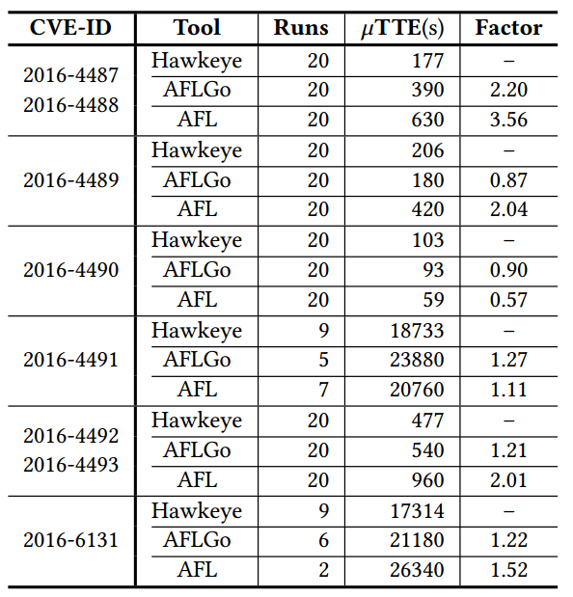
Crash Reproduction (cxxfilt)

Slide 18
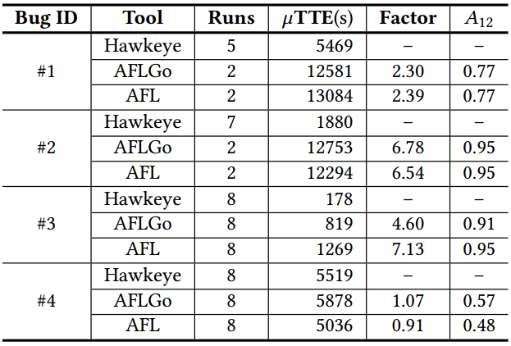
Crash Reproduction (MJS)
#1 Stack Overflow #2 Invalid write
#3 Heap buffer overflow #4 Use after free

Slide 19
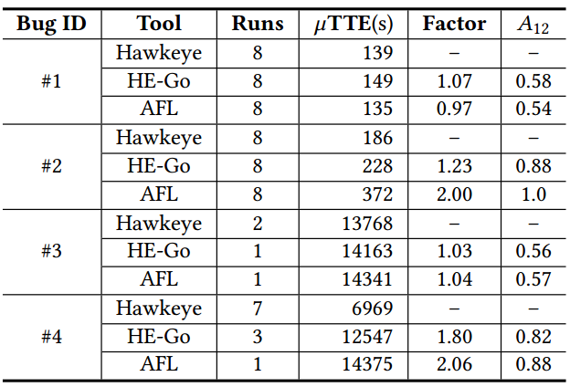
Crash Reproduction (Oniguruma)

Slide 20
MUZZ: Thread-aware Grey-box Fuzzing

Slide 21
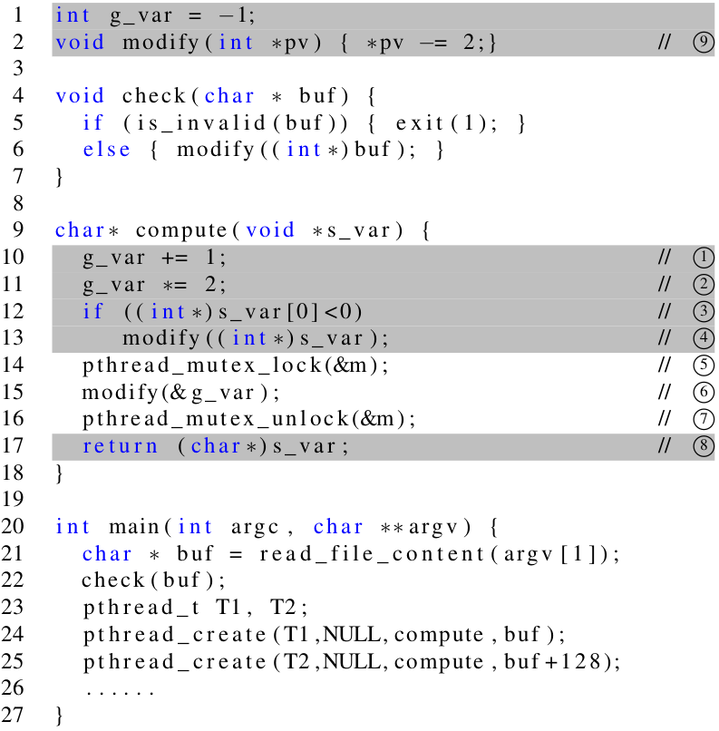
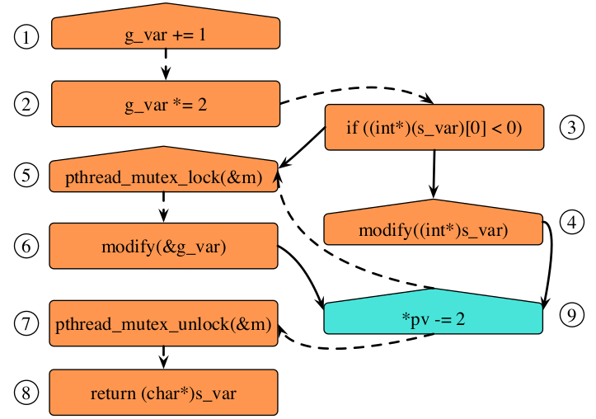
Motivating Example
Not always easy to pass “check”
Not enough coverage feedback caused by thread-interleaving

Slide 22
Existing Fuzzing Issues
Shared variable: g_var
g_var = -1
𝟙: “g_var+=1”
𝟚 : “g_var*=2”
Two threads: T1, T2
Interleaving Sequences | g_var
T1:𝟙 → T2:𝟙 → T2:𝟚 → T1:𝟚 | 4
T1:𝟙 → T2:𝟙 → T1:𝟚 → T2:𝟚 | 4
T1:𝟙 → T1:𝟚 → T2:𝟙 → T2:𝟚 | 2
Existing fuzzers:
are only aware of instruction: 𝟙: “g_var+=1”
only know a transition: 𝟙 → 𝟙

Slide 23
MUZZ’s Improvements
Feedback to track thread-interleavings and thread-context
Coverage-oriented Instrumentation
assigns more deputies to multithreading-relevant segments
to add thread-interleaving feedback
Thread-context instrumentation
distinguishes thread identities
to further differentiate threads
Schedule-intervention across executions
Schedule-intervention instrumentation
adjusts each thread’s priority
to increase the execution diversity to cover more thread-interleavings

Slide 24
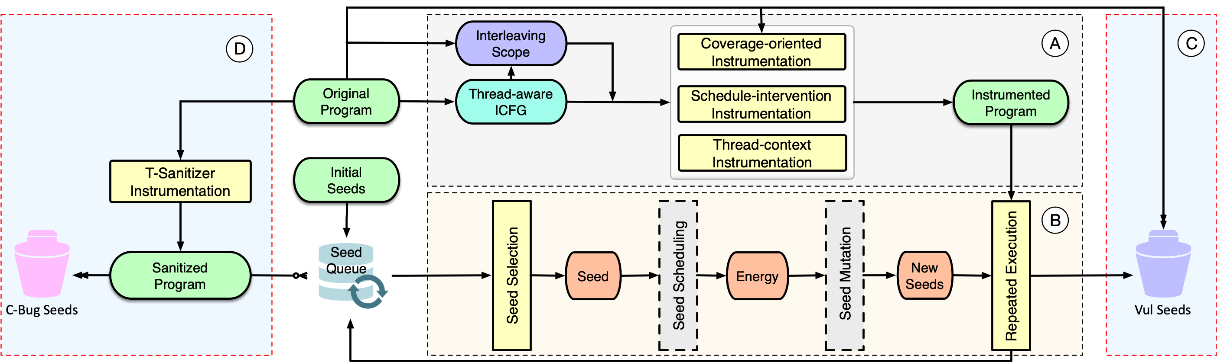
Workflow of MUZZ

Slide 25
Part A: Static Analysis
Construct thread-aware ICFG
TFork, TJoin, TLock, TUnlock, TShareVar
Extract suspicious interleaving scope L_{m} based on ICFG
instructions belonging to L_{m} are likely to interleave with others
Apply coverage-oriented instrumentation based on L_{m} & McCabe complexity
McCabe complexity helps determine instrumentation ratios
Apply thread-context instrumentation based on threading functions
TFork/TJoin, TLock/TUnLock
Apply schedule-intervention instrumentation based on thread-forking routines
TFork

Slide 26
Part B: Dynamic Fuzzing
Seed Selection
prioritize to select seeds with
new coverage (including those caused by thread-interleavings)
new thread-context
to focus on feedback provided by multithreading-relevant traces
Repeated Execution
Repeat more times for executions with non-deterministic behaviors
to focus on behaviors probably caused by thread-interleavings

Slide 27
Part C & D: Vulnerability/Bug Detection
Detect vulnerabilities during fuzzing
“crashes” during fuzzing
manually triage based on root causes
multithreading-relevant
other vulnerabilities
Reveal concurrency-bugs during replaying
with help of ThreadSanitizer
replay with a time-budget
manually triage based on root causes
data-race
lock-order-inversion
…

Slide 28
Experimental Results
MUZZ outperforms thread-unaware fuzzers in both multithreading-relevant seed generation and concurrency-vulnerability detection
MUZZ reveals more concurrency-bugs by replaying the target programs against the generated seeds
8 multithreading-relevant zero-day vulnerabilities
19 new concurrency-bugs

Slide 29
Evaluation Tools
MUZZ: Our thread-aware fuzzer with all the static & dynamic techniques
MAFL: The fuzzer with all MUZZ’s techniques except for coverage-oriented instrumentation
AFL: The state-of-the-art general-purpose grey-box fuzzer

Slide 30
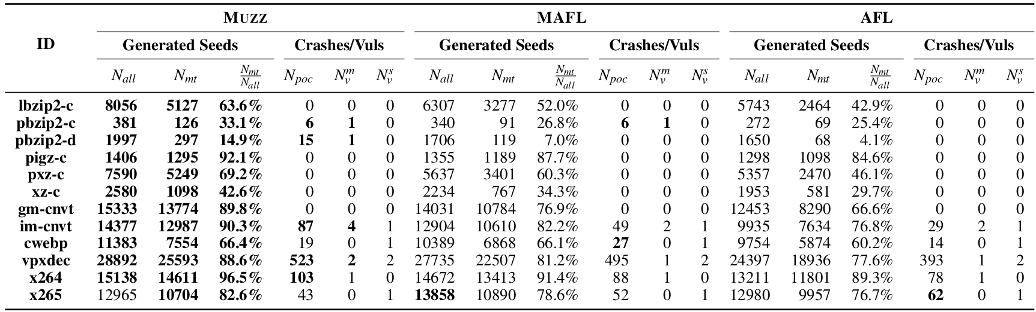
Evaluations on Coverage & Vulnerability Detection

Slide 31
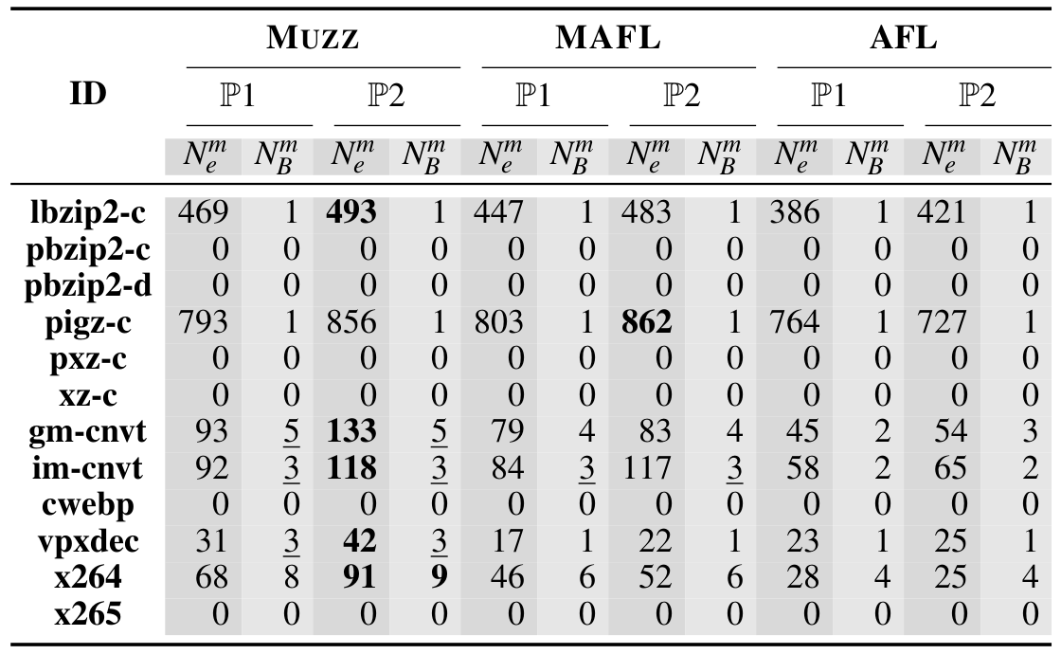
Evaluations on Concurrency-bug Revealing

Slide 32
FOT: General Grey-box Fuzzing Framework

Slide 33
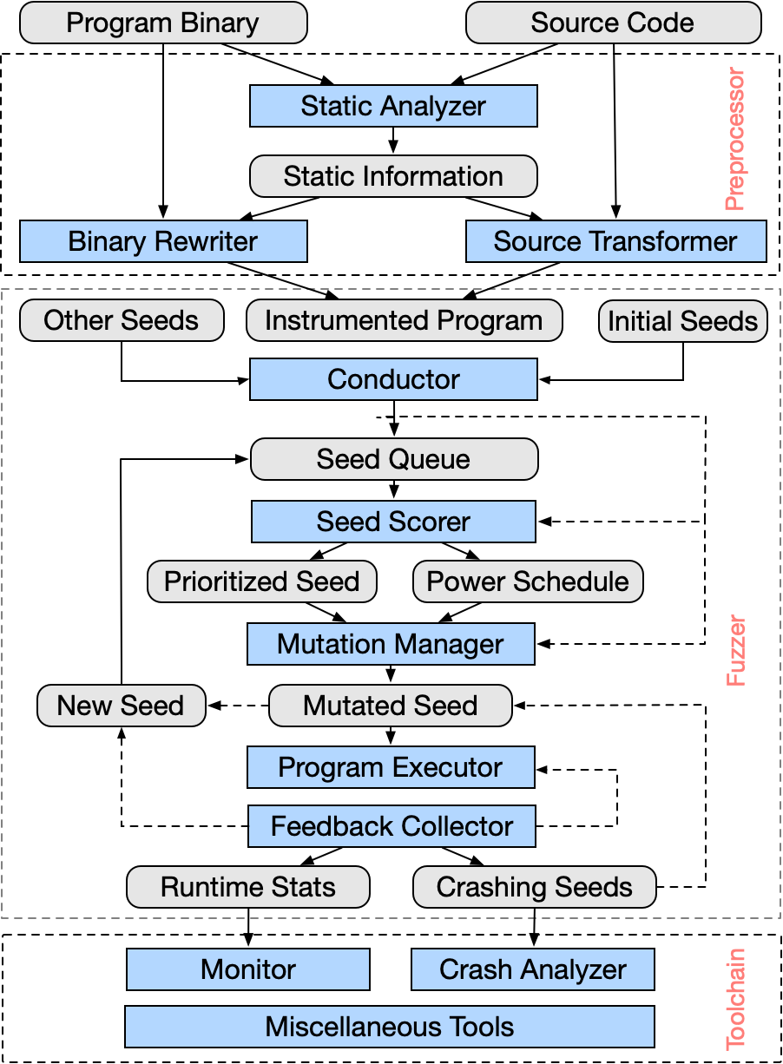
FOT: Fuzzing Orchestration Toolkit
Versatility
Configurability
Extensibility
Components:
Preprocessor
Fuzzer
Toolchain

Slide 34
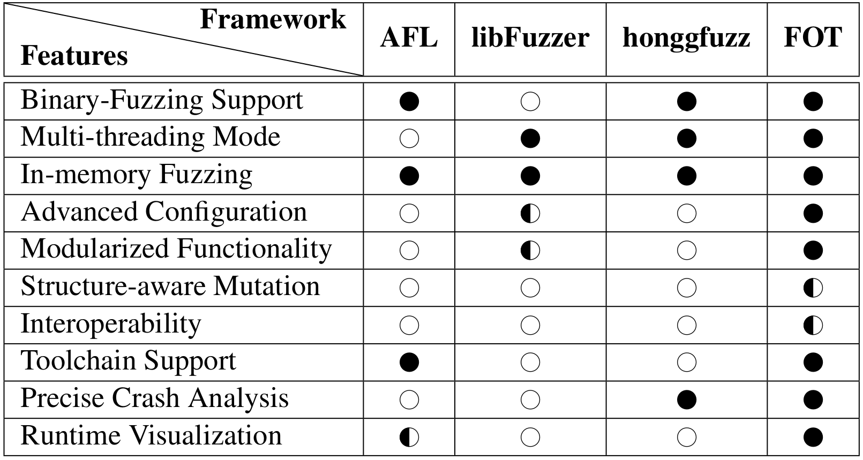
Comparison with Other Frameworks

Slide 35
Trophies
300+ vulnerabilities in 120+ projects
GNU libc
FFmpeg
ImageMagick
...
https: //github.com/ntu-sec/pocs
61 CVEs, 10 with critical/high CVSS3.x severity
CVE-2019-9169 (critical, 9.8)
CVE-2018-17293 (high, 8.8)
CVE-2019-15140 (high, 8.8)
CVE-2018-20819 (high, 7.8)
CVE-2018-11595 (high, 7.8)
CVE-2018-20796 (high, 7.5)
CVE-2018-15822 (high, 7.5)
CVE-2009-5155 (high, 7.5)
CVE-2018-11598 (high, 7.1)
CVE-2018-11593 (high, 7.1)

Slide 36
STA: Permission-Dependent
Security Type System

Slide 37
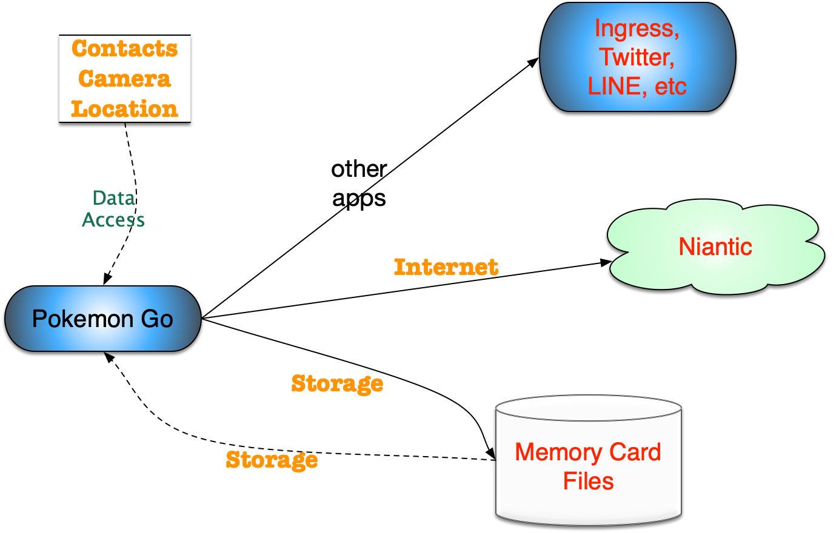
Information flow in Android
How to prove no information leakage?
Testing ☹️
Verification 😉

Slide 38
Type-Based Verification Procedures
Annotate variables with security types (labels)
Provide (security) typing rules for expressions, commands, etc
Prove soundness of the type system against non-interference
……………………………………………………………………………………..
Check whether the given program can be typed with typing rules
If the program is typable, it assures there is no information leakage

Slide 39
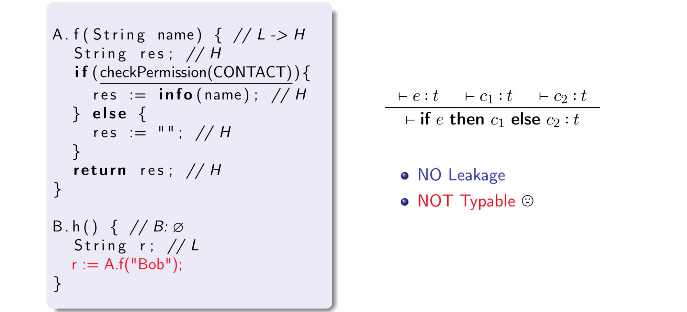
Motivating Example

Slide 40
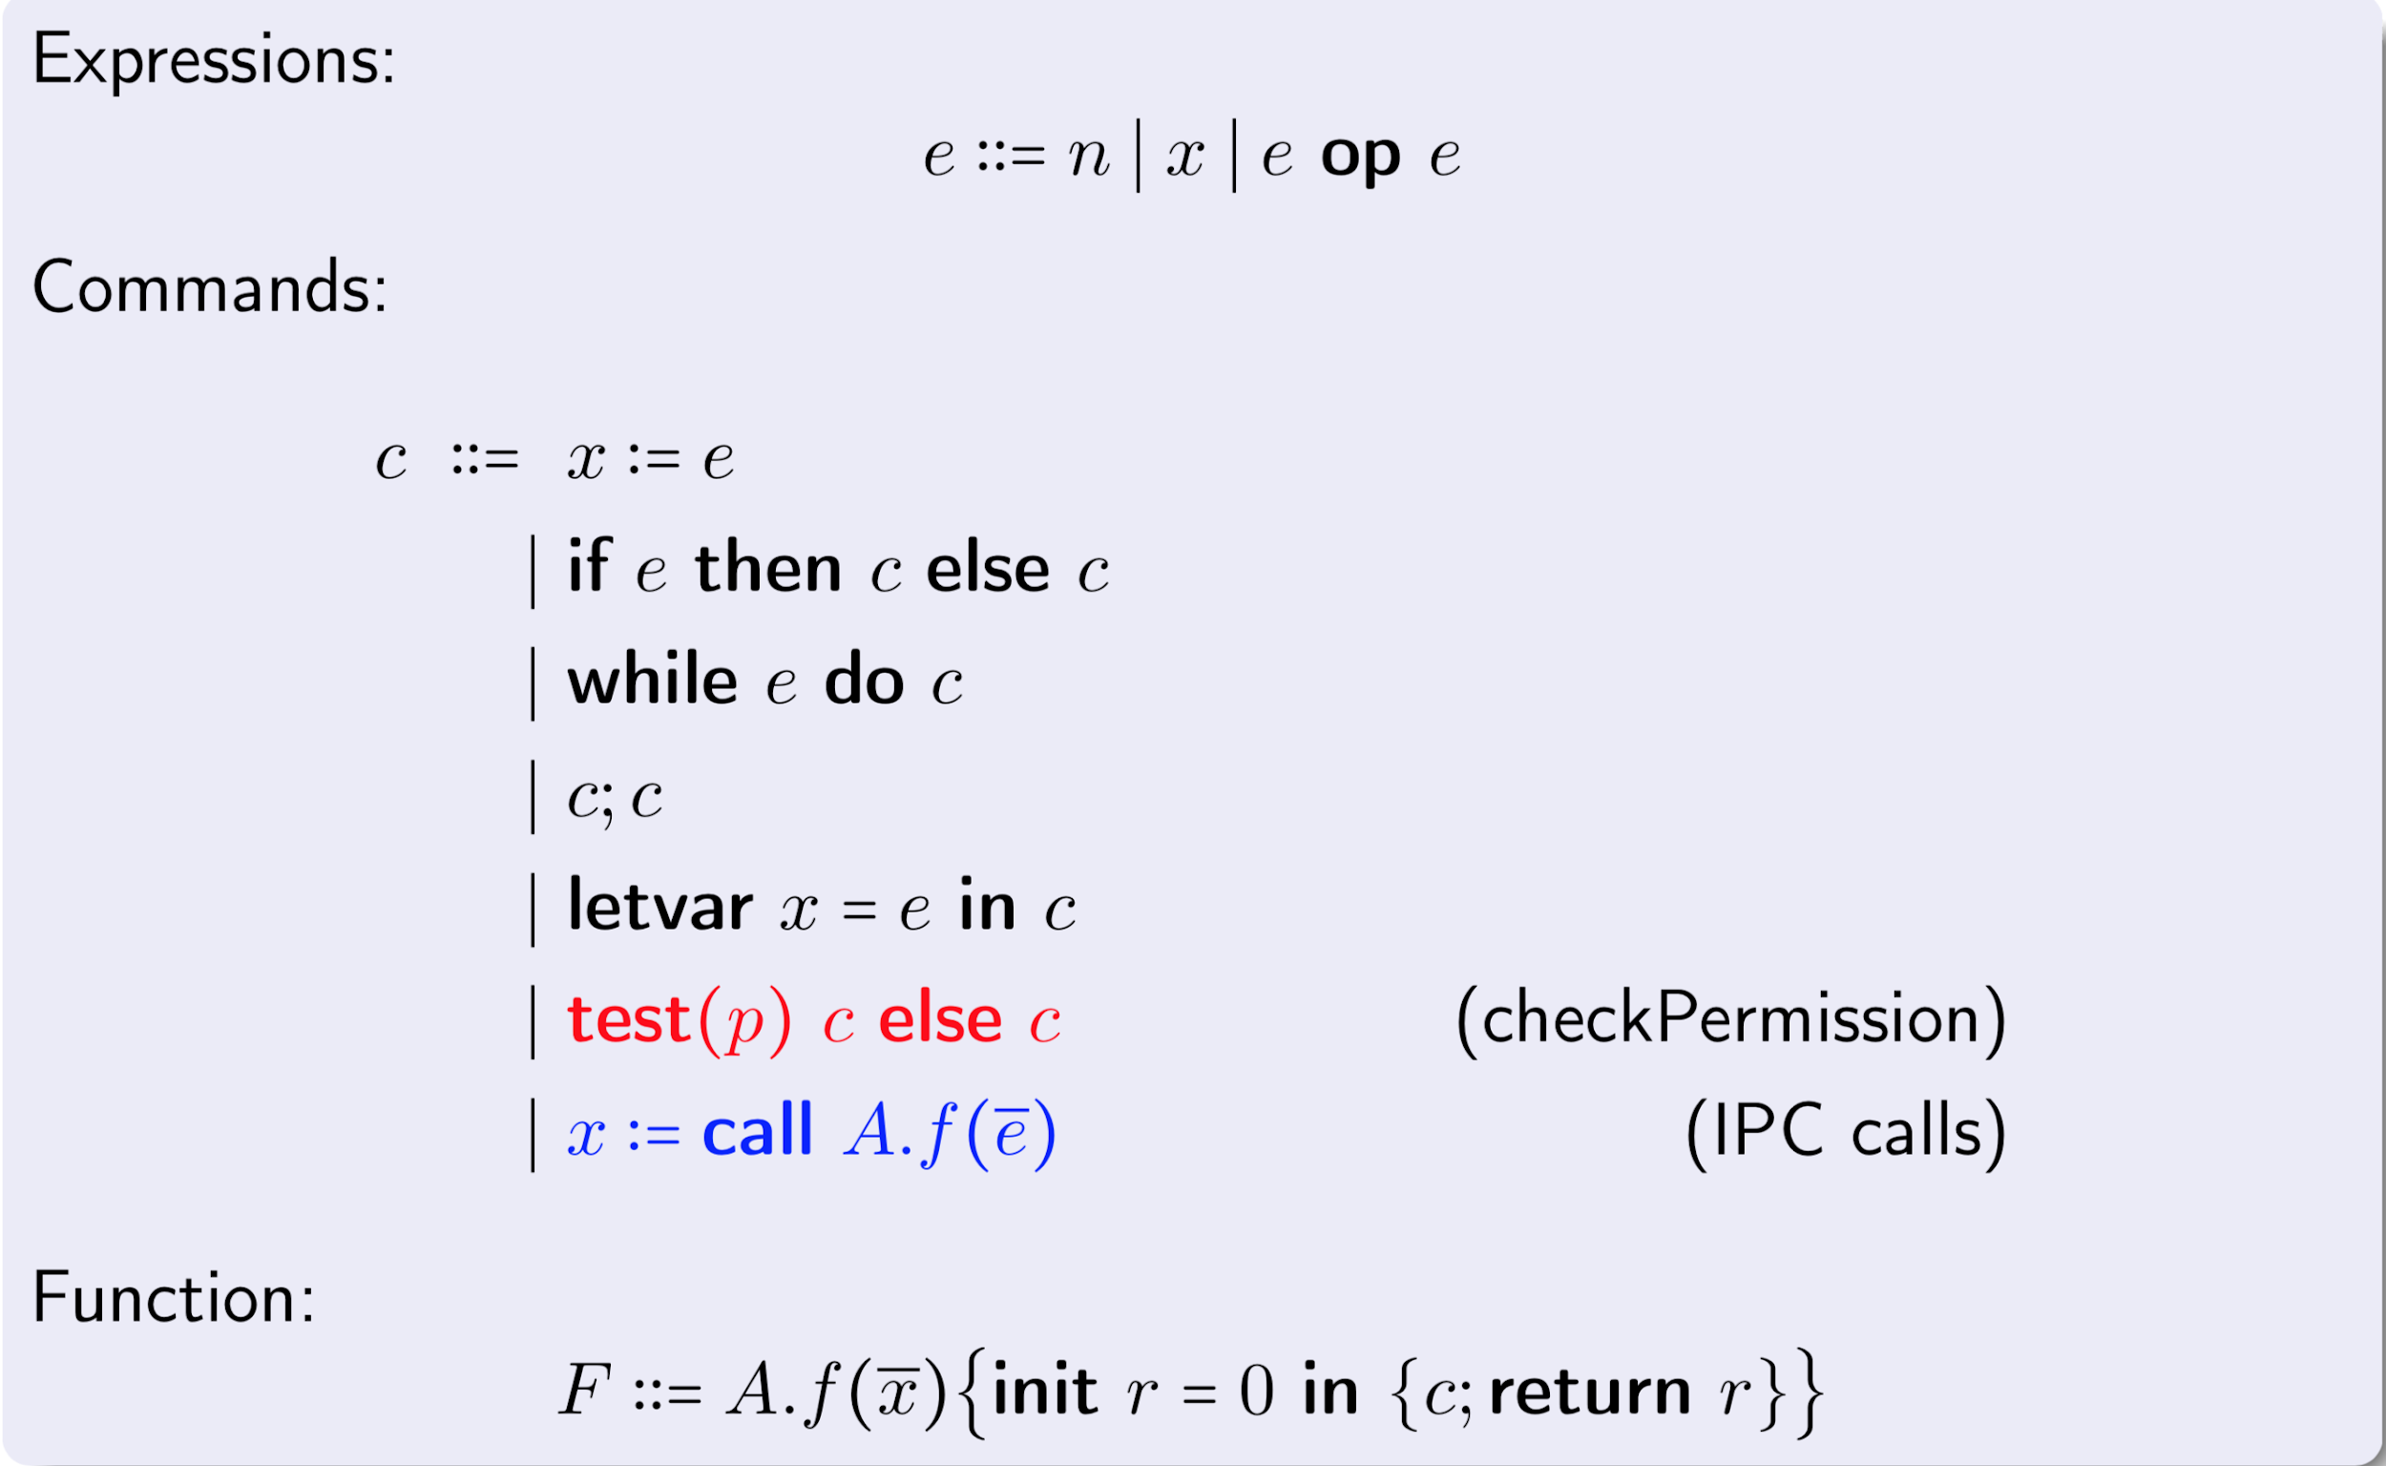
The Language of STA

Slide 41
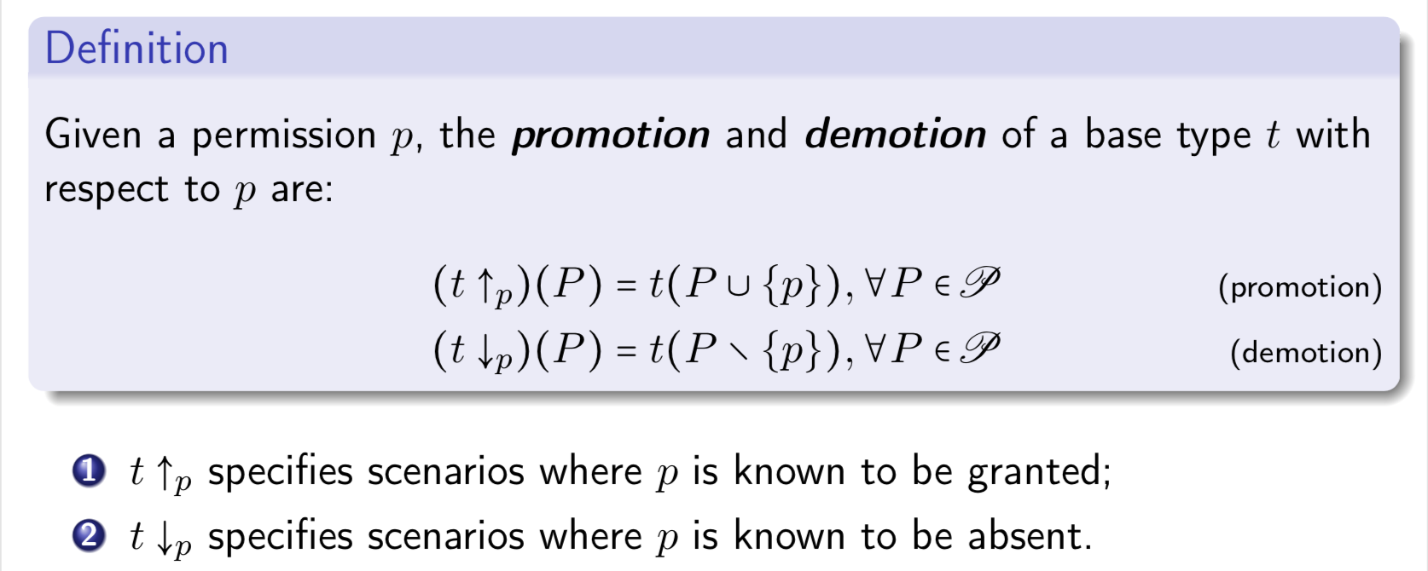
Type Promotion & Demotion

Slide 42
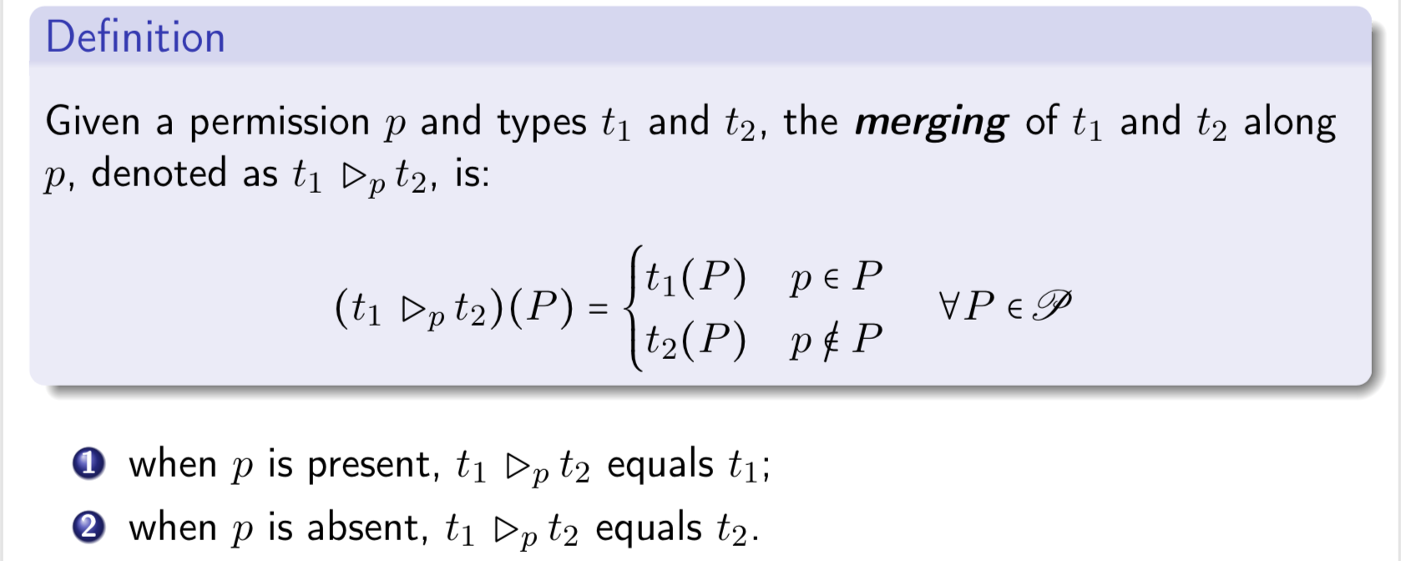
Type Merging

Slide 43
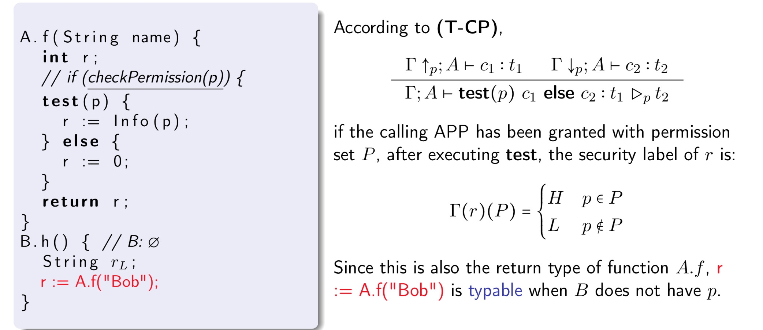
Typing for test Command

Slide 44
Soundness Conclusion
Typable systems are non-interferent.
typable: the target program can be checked with typing rules
non-interferent: attackers know nothing about sensitive values

Slide 45
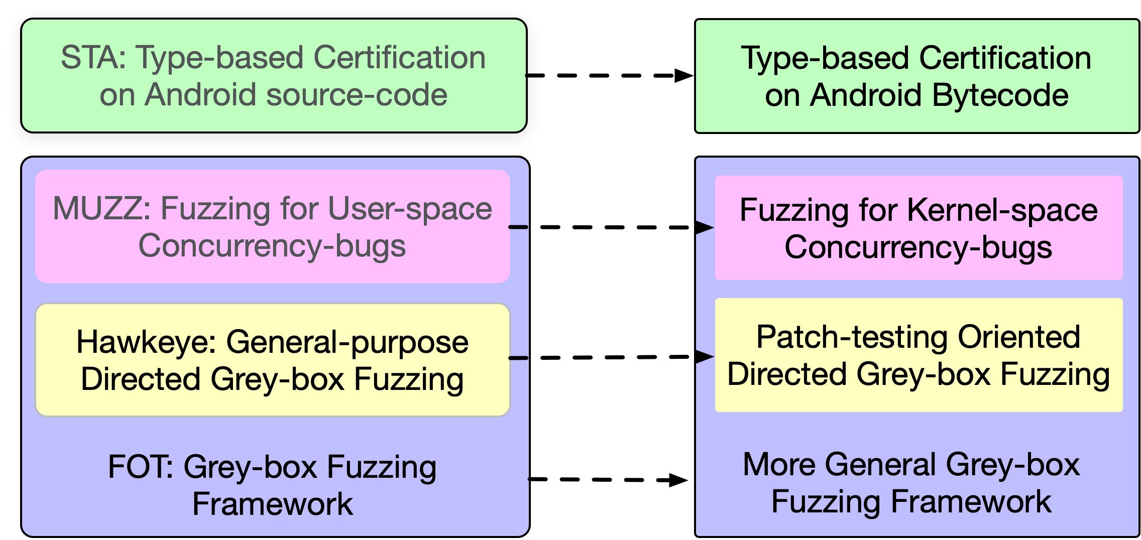
Summary & Future Work

Slide 46
Publications (thesis relevant)
Hongxu Chen, Yinxing Xue, Yuekang Li, Bihuan Chen, Xiaofei Xie, Xiuheng Wu, Yang Liu, “Hawkeye: Towards a Desired Directed Greybox Fuzzer”, CCS’18
Hongxu Chen, Shengjian Guo, Yinxing Xue, Yulei Sui, Cen Zhang, Yuekang Li, Haijun Wang, Yang Liu, “MUZZ: Thread-aware Grey-box Fuzzing for Effective Bug Hunting in Multithreaded Programs”, (under revision).
Hongxu Chen, Yuekang Li, Bihuan Chen, Yinxing Xue, Yang Liu, “FOT: A Versatile, Configurable, Extensible Fuzzing Framework”, ESEC/FSE ’18
Hongxu Chen, Alwen Tiu, Zhiwu Xu, Yang Liu,“A Permission-Dependent Type System for Secure Information Flow Analysis”, CSF’18

Slide 47
Publications (others)
Xiaofei Xie, Hongxu Chen, Yi Li, Ma Lei, Yang Liu, and Jianjun Zhao. Deephunter: A coverage-guided fuzzer for deep neural networks, ASE ’19.
Yuekang Li, Yinxing Xue, Hongxu Chen, Xiuheng Wu, Cen Zhang, Xiaofei Xie, Haijun Wang, and Yang Liu. Cerebro: Context-aware adaptive fuzzing for effective vulnerability detection, ESEC/FSE’19
Yinxing Xue, Guozhu Meng, Yang Liu, Tian Huat Tan, Hongxu Chen, Jun Sun, and Jie Zhang. Auditing anti-malware tools by evolving android malware and dynamic loading technique, TIFS’17
Xiaofei Xie, Yang Liu, Wei Le, Xiaohong Li, and Hongxu Chen. S-looper: automatic sum- marization for multipath string loops, ISSTA’15

Slide 48
Thank you!

